Slide 1
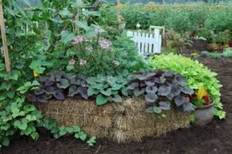
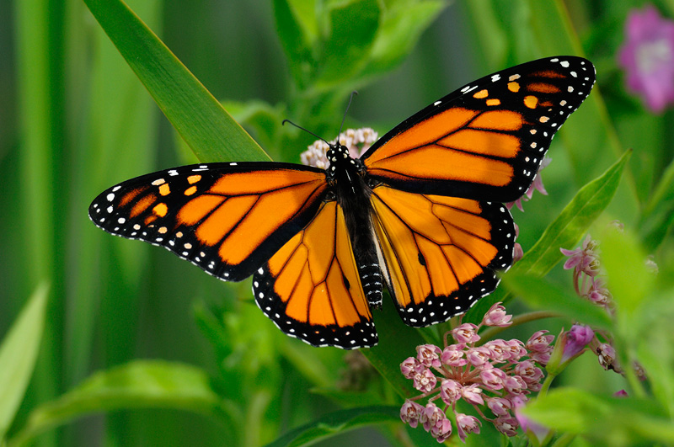
UCCE MASTER GARDENERS OF SANTA BARBARA COUNTY PRESENT A FREE PUBLIC WORKSHOP Create a Butterfly Garden
Get the information you need to create your own butterfly garden!
UCCE Master Gardeners will talk about:
Common butterflies of Santa Barbara County
Elements of butterfly gardens
Plants for pollinators
Questions? 805-893-3485 or cesantabarbara.ucanr.edu
Q
Date: Saturday, March 30, 2019
Time: 10:00am to 12:00am
Where: Alice Keck Park Memoria Garden Butterfly Garden, Santa Barbara. Entrance off Arrellaga between Santa Barbara and Garden Streets.
The University of California prohibits discrimination or harassment of any person in any of its programs or activities. (Complete nondiscrimination policy statement can be found at http://ucanr.edu/sites/anrstaff/files/215244.pdf.) Inquiries regarding ANR’s non-discrimination policies may be directed to John I. Sims, Affirmative Action Compliance Officer/Title IX Officer, University of California, Agriculture and Natural Resources, 2801 Second Street, Davis, CA 95618, (530) 750-1318.
------------------------------------------------------------------------------------------------------------------------------------------------------------------------------------------------------------------------------------------------------------------------------------------------

