Slide 1
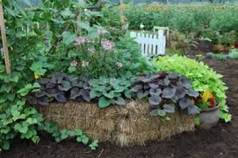
UCCE MASTER GARDENERS OF SANTA BARBARA COUNTY PRESENT A FREE PUBLIC WORKSHOP: STRAW BALE GARDENING
Anything that grows in the ground will grow in a straw bale!
Come and learn about growing gardens in a straw bale!
UCCE Master Gardeners will talk about:
Selecting, preparing and conditioning straw bales
Planting seed and seedlings in them
Caring for the gardens
Questions? 805-893-3485 or cesantabarbara.ucanr.edu
Date: Saturday, February 23, 2019
Time: 10:30am to 11:30am
Where: Stone Pine Hall
200 S. H Street, Lompoc, CA 93436
The University of California prohibits discrimination or harassment of any person in any of its programs or activities. (Complete nondiscrimination policy statement can be found at http://ucanr.edu/sites/anrstaff/files/215244.pdf.) Inquiries regarding ANR’s non-discrimination policies may be directed to John I. Sims, Affirmative Action Compliance Officer/Title IX Officer, University of California, Agriculture and Natural Resources, 2801 Second Street, Davis, CA 95618, (530) 750-1318.
------------------------------------------------------------------------------------------------------------------------------------------------------------------------------------------------------------------------------------------------------------------------------------------------

